Slide 1
Modern Slavery
Training Presentation
2022

Slide 2

Learning Objectives
What is modern slavery?
The Modern Slavery Act
Your responsibilities
Our company’s anti-slavery and human trafficking policy

Slide 3
What is Modern Slavery
“…a catch-all term to describe human trafficking, forced labour, debt bondage, sex trafficking, forced marriage and other slave-like exploitation…”
- World Economic Forum

Slide 4

You make the call: Where is it prevalent?
Where in the world do you think modern slavery is most prevalent?
Africa and the Middle East
Latin America
Most developing countries
Most countries in the world ✓

Slide 5




How big a problem is it?
10,000-13,000
potential victims in the UK
in 2013
$150 billion
generated in illegal profits from forced labour each year
21 million
Victims of forced labour worldwide
46 million
slaves worldwide

Slide 6
Cases
23 cockle pickers drowned in Morecambe Bay
Dozens of workers allege forced labour at
Eritrean mine
Hitachi, Canon and Samsung urged to address forced labour
Nestlé admits forced labour in Thailand supply chain
UN gives Qatar a year to end forced labour

Slide 7
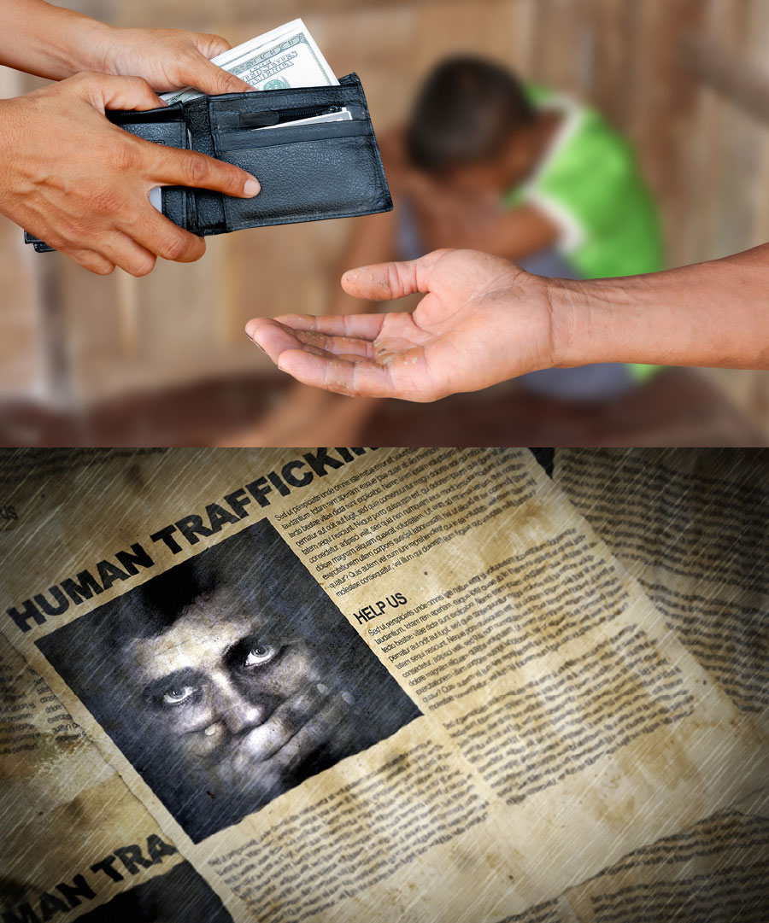
Penalties
Slavery is a criminal offence
Up to life imprisonment

Slide 8
The Modern Slavery Act 2015
Section 54
Our Company has a legal duty to publish:
The steps taken to ensure slavery and human trafficking is not taking place in any of our supply chains or in any part of our business

Slide 9
Who is at risk?
Only women
People in socially-excluded groups
Migrant workers
NO
YES
YES
Children
Those working in agriculture, construction and entertainment
Those undertaking domestic work
YES
YES
YES

Slide 10
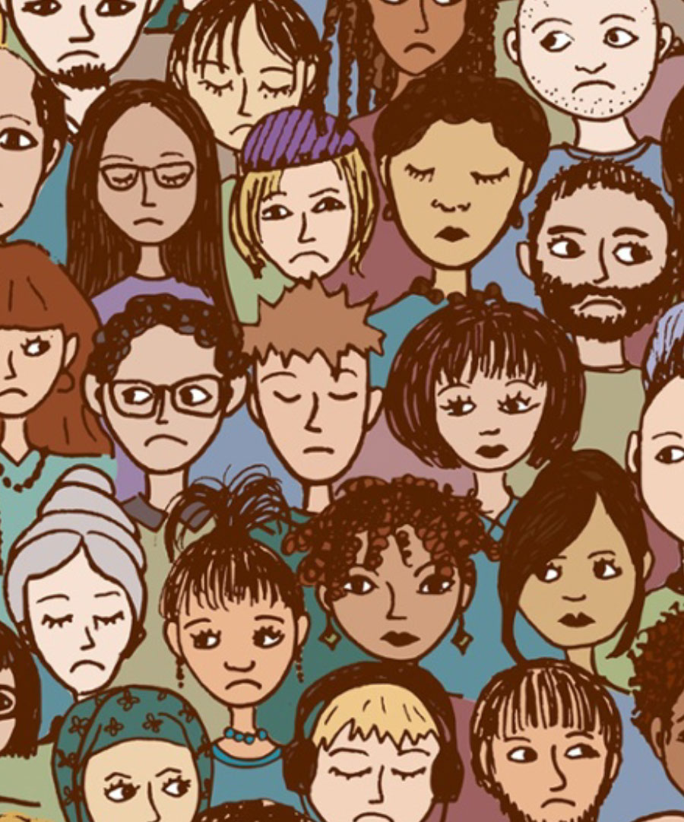
Where is there a risk in our business?
What do you think?
Our facilities and service providers
Our components or goods suppliers
Contract workers
Full-time employees on our payroll
No risk of Modern Slavery in our business

Slide 11
Opinion: Increased risk?
This doesn’t just happen on the other side of the world. It’s happening right now in Paris, London and every other capital city. To cleaners, security guards, restaurant and hotel workers. We need to wake up
The anti-immigration sentiment across Europe is a gift to traffickers. Migrant workers will stay under the radar, making them more vulnerable to exploitation
Migrants without the right to remain are hardly likely to complain about unpaid wages and poor treatment

Slide 12
Opinion: Increased risk?
This doesn’t just happen on the other side of the world. It’s happening right now in Paris, London and every other capital city. To cleaners, security guards, restaurant and hotel workers. We need to wake up
The anti-immigration sentiment across Europe is a gift to traffickers. Migrant workers will stay under the radar, making them more vulnerable to exploitation
Migrants without the right to remain are hardly likely to complain about unpaid wages and poor treatment
Notes:
[Hold a discussion with delegates, canvassing opinion before continuing. What do you think?]

Slide 13
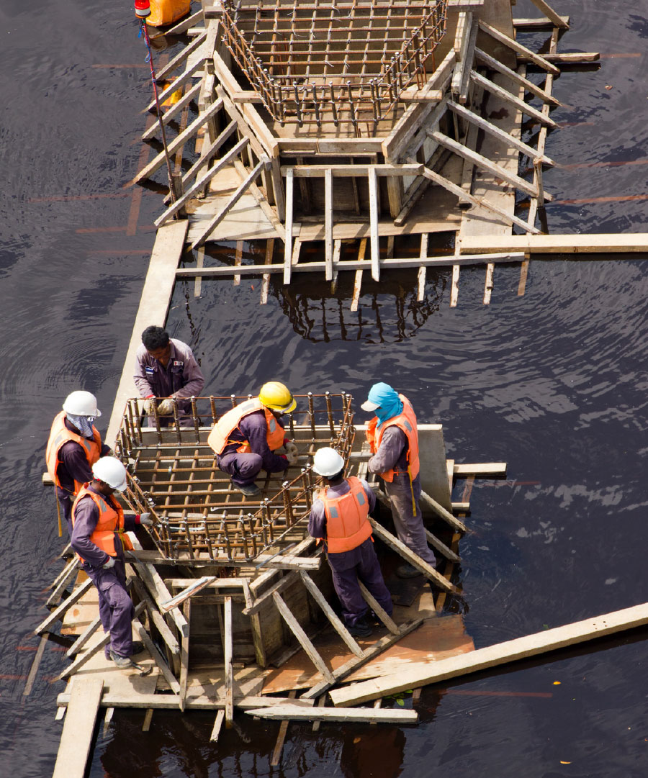
Whose responsibility is it?
Who is responsible for preventing modern slavery in our business and supply chains?
You
Senior management
Procurement managers
Supplier relationship managers
Legal and compliance
Notes:
Who is responsible for preventing modern slavery in our business and supply chains?
[Allow time for discussion and reading before clicking Next.]
We all have a role to play in preventing modern slavery. Let’s find out what you can do…

Slide 14
Potential signs of modern slavery
Signs of physical or psychological abuse
Lack of personal documents
Lack of personal effects
Poor living conditions
Restricted movement or isolation
Notes:
You have a duty to look out for and report possible cases of modern slavery with anyone associated with our company, including in our supply chains.
What should you look for? What signs might indicate someone could be a victim of modern slavery?
[Hold a discussion first before clicking next and giving examples for each bullet.]
Signs of physical or psychological abuse – eg injuries, bruises, nervous, withdrawn, fearful, avoids eye contact, is malnourished, lack of dental care or health care, etc
Lack of personal documents – eg no ID or passport, no financial records, having no control over their money, etc
Lack of personal effects – eg wearing the same clothes every day, which are dirty and/or unsuitable for the season or conditions, etc
Poor living conditions – eg living in dirty, cramped or crowded conditions
Restricted movement – eg being collected and dropped off every day, not being allowed to speak for themselves, always having someone else present, etc
Isolation – eg lack of familiarity with their neighbourhood or where they work, being unable to travel alone, limited or no interaction with others, etc
Victims may appear frightened, avoid eye contact and be reluctant to seek help, not knowing who they can trust. They may even refuse help from you, fearing deportation or violence to them or their families.

Slide 15
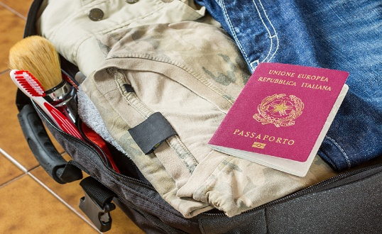
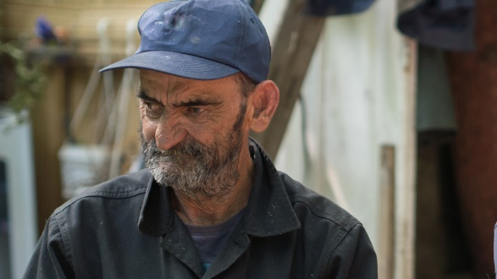

You make the call: Is it suspicious or not?
Having no identification or personal effects
Suspicious ✓
Not suspicious
Not sure
Wearing the same clothes daily, which are unsuitable for the work or conditions
Suspicious ✓
Not suspicious
Not sure
Being dropped off or picked up every day, with someone else always present
Suspicious ✓
Not suspicious
Not sure
Notes:
Look at this example and decide whether it is suspicious or not.
[Show each one in turn and allow time for reading and making a decision before clicking Next.]
Be vigilant and watch out for potential signs of slavery.
[Optional content – time permitting.]
Remember there may be signs in your local community too. For example:
People who never come out of a house without a guardian present and have limited English
Faces at the windows of a property who you never see outside
Minibuses or vans collecting foreign workers at unusual times
Children being collected from school by different people who are unrelated to them
Teenage girls being driven by older men who are not related
An overcrowded property with frequent visitors that are often in a poor state of repair – perhaps with the letterbox blocked and CCTV outside

Slide 16
What should you do?
That’s suspicious. It doesn’t feel right to me.
Speak to the worker about their rights
Encourage the worker to report it to a newspaper
Find out who their minder is and report it to the police
Report your suspicion to Legal or Compliance
Ignore it – there’s nothing you can do
✓
Notes:
What should you do if you notice signs of modern slavery?
[Allow time for discussion and reading before clicking next.]
If you spot any signs of slavery, it’s very important that you do not attempt to investigate or confront those responsible.
This will only tip off the perpetrator and jeopardise the victim’s safety.
Instead, just report it to your manager or a Legal and Compliance officer. Remember, traffickers are dangerous criminals so don’t put yourself at risk.

Slide 17

Scenario 1: In the hospital
What should she do?
Challenge her brother outright and call the police
Report her suspicions to her manager
Speak to her patient about her rights
Ignore it – there’s nothing she can do without concrete evidence
✓
The story about her injuries just wasn’t credible. She was very withdrawn. He was reluctant for me to examine her alone.
Notes:
Maria is a nurse in an NHS hospital.
A young female is brought in by her brother for treatment. She’s very withdrawn. Her brother says she speaks very little English and is somewhat domineering.
Maria notices a number of older injuries on her patient’s body. Her clothes are dirty and broken, and she has poor hygiene. Maria suspects she may be a victim of modern slavery as she cannot describe her neighbourhood or tell her where she lives.
What should she do?
[Allow for discussion and thinking time before clicking next again]
Maria must not put herself in danger or tip off her patient’s brother. It’s best to report her concerns immediately to her manager or Legal/Compliance.

Slide 18

Scenario 2: In the community
What should he do?
Confront visitors entering the property to find out what’s going on
Knock on the door and see if he can help in some way
Call the Modern Slavery helpline or the police
Ignore it – he has no clear evidence and shouldn’t make assumptions
✓
She looks so sad. Why haven’t I seen her out shopping?
Notes:
Ashar walks along the same street every day taking his kids to school. There’s a house on the corner where the curtains are always drawn, day and night.
He’s not sure who lives there. But, there are lots of visitors at unsocial hours. The letterbox is blocked and there are CCTV cameras outside. Odd, he thinks, as the place looks so neglected.
He’s occasionally seen faces at the window but he’s never seen the women outside.
What should he do?
[Allow for discussion and thinking time before clicking next again]
Traffickers are organised criminals and can be extremely dangerous. The best course of action here is to report his concerns immediately to the Modern Slavery Helpline (08000 121 700) or the police.

Slide 19
Our Anti-Slavery and Human Trafficking Policy
Providing information and training – to raise awareness
Identifying parts of our business and supply chain where there is a risk of slavery or human trafficking
Implementing systems and controls to manage the risks
Conducting due diligence in relation to slavery and human trafficking in our business and supply chains
Assessing our effectiveness in preventing slavery and human trafficking in our business and supply chains, using performance indicators
Requiring everyone to read and implement our Anti-Slavery and Human Trafficking Policy
Notes:
Our Anti-Slavery and Human Trafficking Policy sets out our rules, processes and procedures.
We demonstrate our commitment to combatting slavery and human trafficking by:
Providing information and training – to raise awareness
Identifying parts of our business and supply chain where there is a risk of slavery or human trafficking
Implementing systems and controls to manage the risks
Conducting due diligence in relation to slavery and human trafficking in our business and supply chains
Assessing our effectiveness in preventing slavery and human trafficking in our business and supply chains, using performance indicators
Requiring everyone to read and implement our Anti-Slavery and Human Trafficking Policy
[As an add-on, provide everyone with a copy of your Anti-Slavery and Human Trafficking Policy and explain the key points. You might also introduce anyone specifically appointed with responsibility for this in the session giving them a 5-min slot to explain their work and offer advice.]

Slide 20
Do
Read our Company's Anti-Slavery and Human Trafficking Policy – make sure you understand our rules and know what is expected of you
Be vigilant - watch out for signs of modern slavery
Report any issues or concerns immediately to your manager or Legal/Compliance
Notes:
We can’t do this alone. Here's what you should do:
Read our Company's Anti-Slavery and Human Trafficking Policy – make sure you understand our rules and know what is expected of you
Be vigilant - watch out for signs of modern slavery, including physical and psychological signs
Report any issues or concerns immediately to your manager or Legal/Compliance

Slide 21
Don’t
Confront perpetrators of slavery or trafficking – they are dangerous criminals and should not be approached
Try to gather evidence – this may tip off the perpetrator and put the victims at greater risk
Wait for someone else to report it – take responsibility yourself
Do anything to compromise your own or others’ safety
Notes:
Don't:
Confront perpetrators of slavery or trafficking – they are dangerous criminals and should not be approached
Try to gather evidence – this may tip off the perpetrator and put the victims at greater risk
Wait for someone else to report it – take responsibility yourself
Do anything to compromise your own or others’ safety

Slide 22
Any questions, concerns or comments?

Slide 23


Next steps
Contact management@aheadmg.com if you need information or guidance
Contact management@aheadmg.com if you need to raise concerns
Access self-study courses www.AheadMG.com/training for further training
Notes:
You can get more help and information on this issue from these contacts.
Or, for a more in-depth look at this topic, access our self-study course.

