Slide 1
Money Laundering
Training Presentation
2022

Slide 2
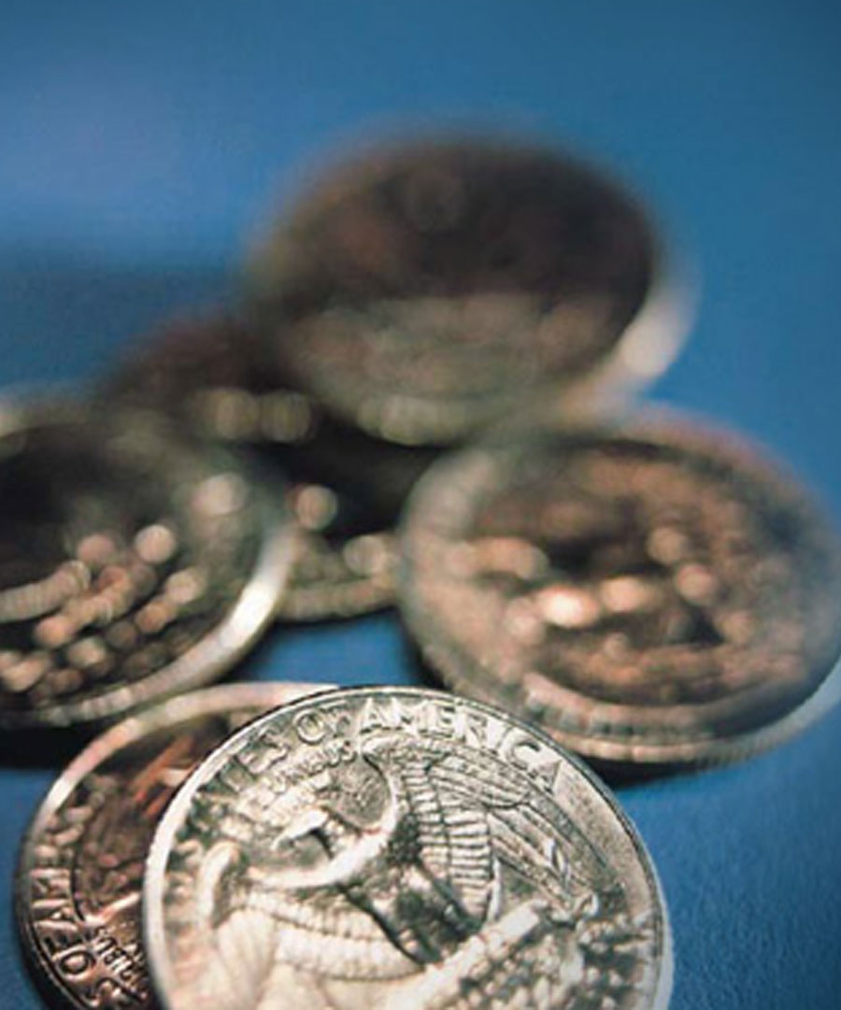
Learning Objectives
What is 5MLD?
What’s new and what’s changed under 5MLD?
What is 6AMLD?
What’s new and what’s changed under 6AMLD?
Your responsibilities
What we should do to get ready
Our company’s Anti Money Laundering and Financial Crime policy

Slide 3
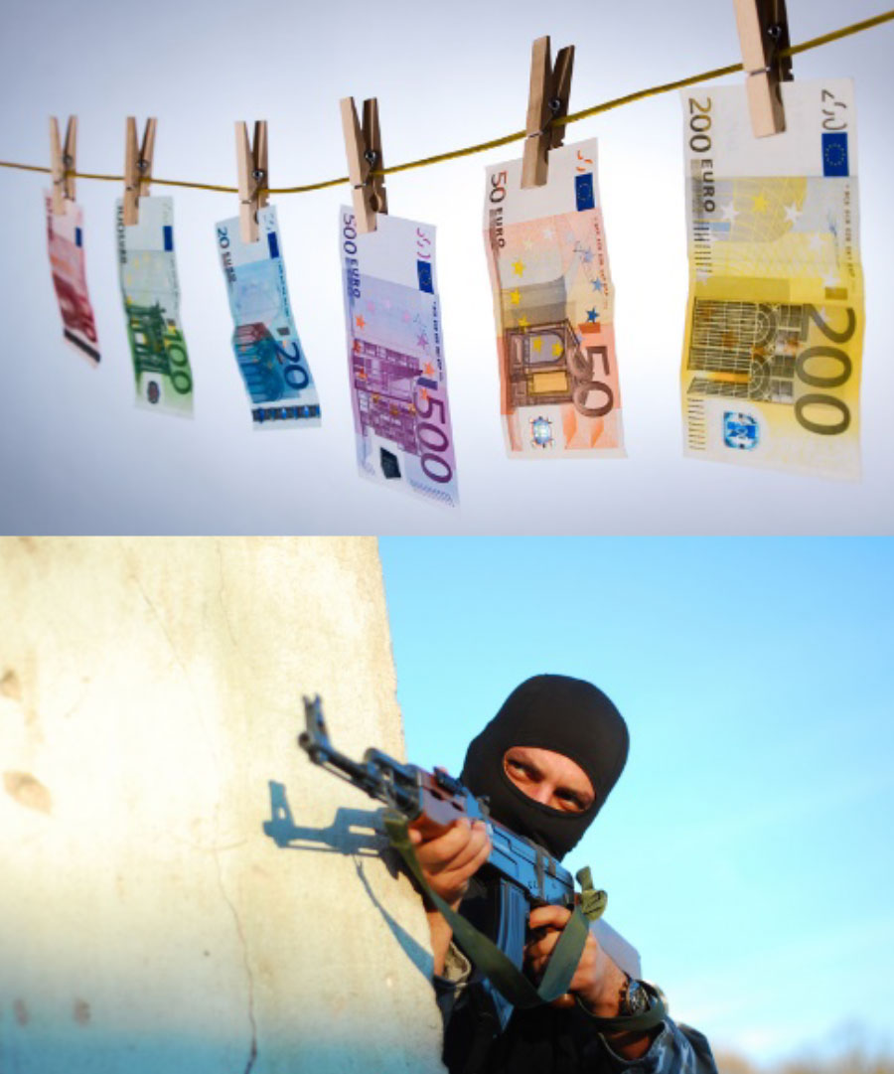
What is 5MLD?
The Fifth Money Laundering Directive:
Inclusion of Virtual Assets (eg. Crypto currencies)
More clarity around PEP risk management and beneficial ownership
A common interpretation of what Enhanced Due Diligence means.
Identification of prepaid card holders.
Information sharing by Financial Intelligence Units.

Slide 4
What is Money Laundering?
…the process by which criminals attempt to conceal the identity, source or destination of illicit funds
Dirty Money
Clean Money
1.
Placement
2.
Layering
3.
Integration

Slide 5
Four categories of money laundering?
Converting or transferring property, knowing it’s derived from criminal activity, to conceal the illicit origin or assist those involved in criminal activity to evade the law
Concealing or disguising the true nature, source, location, disposition, movement, rights, with respect to, or ownership, of property knowing it’s derived from criminal activity
Acquiring, possessing or using property, knowing at the time of receipt that it was derived from criminal activity or from participating in criminal activity
Participating in, association to commit, attempting to commit and aiding, abetting, facilitating and counselling the commission of any of the above

Slide 6

What is terrorist financing?
Where money is raised for an offence that has yet to be committed
Difficult to identify
Funded from legitimate or apparently legitimate sources
Wealthy individuals
Commercial enterprises
Charities and religious organisations
State sponsors

Slide 7

You make the call: Is it money laundering?
“I only deal with other financial institutions so there’s no risk of money laundering"
Correct
Incorrect ✓

Slide 8

You make the call: Is it money laundering?
“I deal mainly with business accounts so I’m unlikely to encounter money launderers there"
Correct
Incorrect ✓

Slide 9
When it goes wrong
Deutsche Bank fined £502m for money laundering in Russia
Barclays fined £72m for PEP due diligence failures
HSBC fined £1.2bn for money laundering
Coutts fined by Swiss and Singapore regulators for AML failings
Gala Coral pays out £846k for money laundering failings

Slide 10
What’s new?
Tightening rules for prepaid cards
Regulation of Virtual currencies
National register of Beneficial Owners
More clarity around PEP risk management
Improved safeguards for transactions to and from high-risk jurisdictions
Greater powers for FIUs

Slide 11
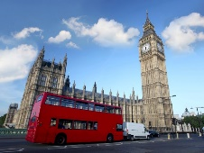



What’s changed?
Enhanced PEP risk management
Expanded scope – to now cover all the virtual currencies and art dealers
Identification of prepaid card holders

Slide 12
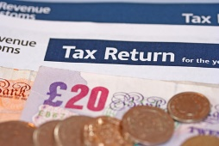


What’s changed? (Cont.)
Beneficial ownership
Electronic identification
More powers for FIUs
Enhanced Due diligence – more clarity, more responsibility

Slide 13

You make the call: Is it True or False?
“We work with major credit and financial institutions so we can waive due diligence checks for these FIs. And they should also do the same for us."
True
False ✓

Slide 14

You make the call: Is it True or False?
“PEPs must still be treated as such for up to 12 months after they have left office"
True ✓
False

Slide 15
Penalties
10%
of total annual turnover
€5
million
Cease and desist orders
Publicly issued reprimands
Financial and reputational damage

Slide 16
What is 6MLD?
The Sixth Anti-Money Laundering Directive:
Dual criminality for specified offences and greater co-operation
Harmonisation and clarification of predicate offences
Extension of criminality to legal persons
A tougher punishment regime overall
Additional offences, such as aiding and abetting

Slide 17
When it goes wrong
Danske Bank faces $2bn fine for money laundering in Estonia
Deutsche Bank fined $150m for dealings with Epstein and AML failings
Westpac pays $1.3bn in money laundering case
Standard Chartered fined £842m by US and UK regulators for AML and sanctions violations
Betway pays record £11.6m for money laundering failures

Slide 18
What’s new?
Dual criminality for specified offences
Greater co-operation between member states to prosecute offences
Harmonisation and clarification of predicate offences
Extension of criminal liability to legal persons and key business leaders
A tougher punishment regime overall
Additional offences, such as aiding and abetting

Slide 19

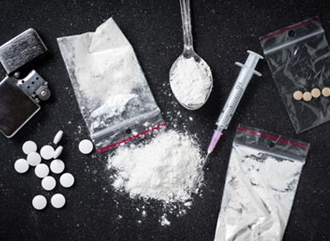

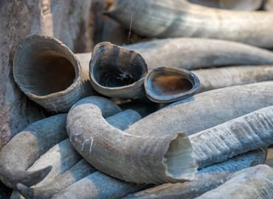
What’s changed?
Dual criminality for specified offences
Greater co-operation between member states – enabling prosecutions in a single member state
Harmonisation and clarification of predicate offences

Slide 20

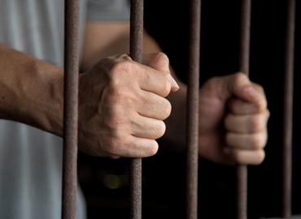


What’s changed? (Cont’d)
Extension of criminal liability to firms and those in authority – holding those in authority to account for AML failings
A tougher punishment regime – increasing minimum prison terms for money laundering from one to at least four years
Additional offences to pursue enablers or facilitators of money laundering

Slide 21
You make the call: Is it True or False?
“Honestly, I don’t see what environmental crime has to do with money laundering. It’s not really relevant."
True
False ✓

Slide 22
You make the call: Is it True or False?
“In future, firms can expect to be held much more accountable for AML compliance failings. Those in authority may face prosecution for poor supervision.”
True ✓
False

Slide 23
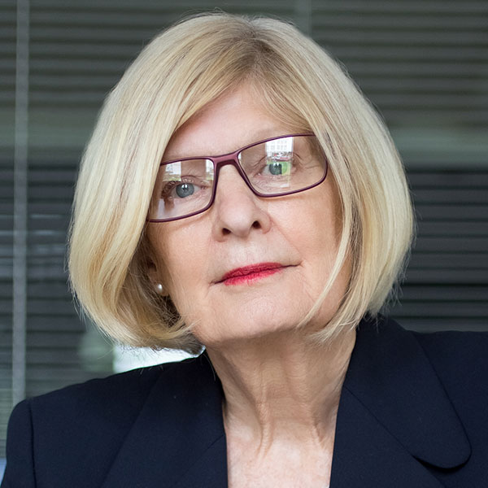
You make the call: Is it True or False?
“As a legal advisor, it is not my job to prevent money laundering. I can’t be expected to scrutinise every client. I don't see what I can do anyway.”
True
False ✓

Slide 24
Penalties
10%
of total annual turnover
€5
million
Cease and desist orders
Publicly issued reprimands
Financial and reputational damage

Slide 25
Sanctions for legal persons
Exclusion from public funding, aid or tenders
Temporary or permanent ban from the sector
Judicial supervision
Enforced closure and winding-up

Slide 26
Our Anti Money Laundering and Financial Crime Policy
Encouraging everyone to get involved
Appointing people with a specific responsibility for handling suspicious activity or transactions (MLRO)
Co-operating fully with regulators and law enforcement to tackle money laundering and terrorist financing
Requiring everyone to read and implement our AML/CTF Policy

Slide 27
Do
Read our Company's AML&FC Policy – make sure you understand the rules and what you need to do
Conduct appropriate risk-based due diligence
Know how to spot 'red flags' - ie unusual or suspicious activity
Make sure you know the name of your MLRO and how to contact them
Be aware of high-risk non-EU countries with deficient AML/CTF regimes (those on the 'blacklist') – take extra care with transactions involving people or entities based there
Report any knowledge or suspicion of money laundering or terrorist financing immediately

Slide 28
Don’t
Assume that another colleague, department or company has made the necessary due diligence checks
Make payment transfers to people or entities in high risk non-EU countries without conducting enhanced due diligence
Leave it for someone else to report concerns about suspicious customers or transactions
Delay making reports or wait until you have gathered more evidence - the faster you make your report, the better
Bypass any of our controls to circumvent AML/CTF regulations or assist clients with this – you will be caught!

Slide 29
What we should do to get ready
Awareness, training and information – is everyone aware of the pending changes within the new regulations and its impact on them? (including senior management)
Review our current AML/CTF regime and framework – especially awareness of the predicate offences, the risks and typologies, dual criminality for specified offences, and the detection of potential enablers
Review our current AML/CTF regime – especially looking at PEPs, high risk jurisdictions and relationships with virtual currency providers
Explore Regulatory Technology (RegTech) solutions to deliver more sophisticated monitoring and ease the regulatory burden
Put mechanisms in place to improve co-operation with competent authorities in other member states where offences span different jurisdictions
Have a clear strategy on how to use technology to improve the ID&V process
Resources in place to ensure relevant data is held securely and easily retrievable
Monitor and review - benchmarking

Slide 30

5MLD & 6AMLD and you
Discuss:
How will 5MLD and 6AMLD impact on our business unit, department, function and/or firm?
Key priorities
[Allow 15 mins]

Slide 31
Any Questions?

Slide 32

Next steps
Contact management@aheadmg.com if you need information or guidance
Contact management@aheadmg.com if you need to raise concerns
Access self-study courses at www.AheadMG.com for further training
Notes:
You can get more help and information on this issue from these contacts.
Or, for a more in-depth look at this topic, access our self-study course.

