Slide 1
Anti-bribery Training
Training Presentation
2022

Slide 2
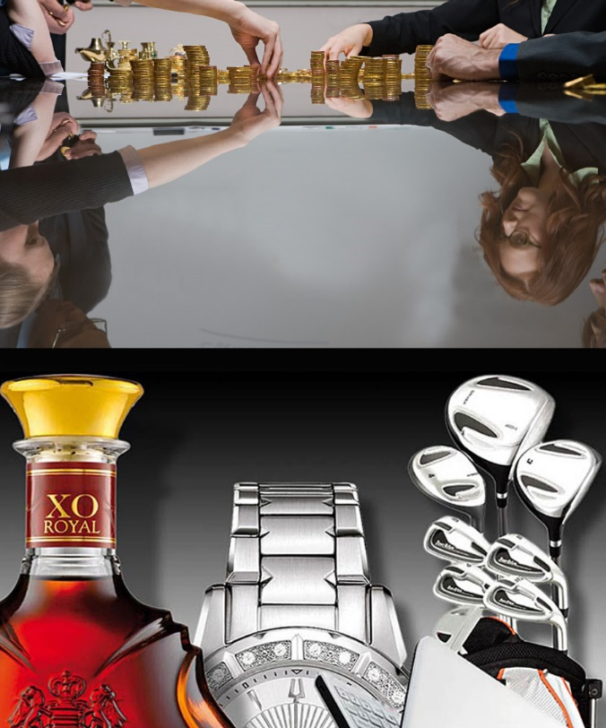
Learning Objectives
What is bribery?
Anti-bribery law
Gifts and hospitality
Third parties and foreign public officials
Our company’s anti-bribery policy

Slide 3
What is Bribery
“…the offering, promising, giving, accepting or soliciting of an advantage as an inducement for an action which is illegal, unethical or a breach of trust...”
- Transparency International

Slide 4
The Law and Bribery
The UK Bribery Act 2010
4 offences
Extra-territorial reach
In the US, bribery is prohibited under the Foreign and Corrupt Practices Act (FCPA)

Slide 5
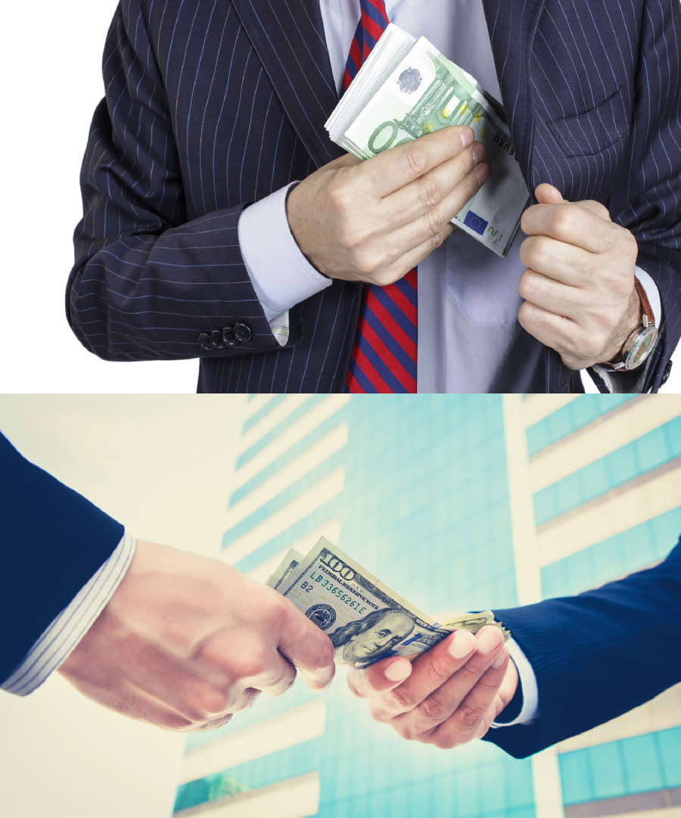
4 Offences
Paying or offering to pay a bribe (active bribery)
Receiving a bribe, favour or other advantage (passive bribery)
Bribing a foreign public official
Failing to prevent bribery

Slide 6
Penalties
Individuals found guilty of bribery can face up to 10 years' imprisonment and unlimited fines
Companies convicted of bribery or failing to have adequate controls to prevent it can face unlimited fines
Directors and senior officers of companies convicted of bribery or failing to prevent it can themselves be found guilty and punished accordingly

Slide 7
When it goes wrong
Rolls-Royce fined £671m for bribery
Housing manager jailed for 3½ years for taking bribes from building contractors
Goodyear fined $16m for failing to prevent bribery
Petrobras faces $2.5bn fine for bribery
Glaxo pays $20m to settle bribery charges

Slide 8
You make the call: Is it a breach or not?
I was offered tickets to the big game – I knew why but I didn’t refuse
In exchange for the contract, he sorted out a job for my son
We met all the official’s travel costs, including those of her spouse
Breach ✓
No Breach
Breach ✓
No Breach
Breach ✓
No Breach

Slide 9
Gifts and hospitality
Acceptable:
Bona fide hospitality and promotional expenditure
To improve our company image, present products or services, establish cordial relations with clients
Not acceptable:
Any gift, hospitality or expense that seeks to influence the recipient into performing their function improperly

Slide 10
Key criteria
Is it legitimate?
Is it proportionate?
Is it transparent?
Timing and context are key!

Slide 11
You make the call: Is it True or False?
Timing is everything – we must be extra careful if a contract is up for renewal
If a supplier offers generous hospitality, it’s courteous to accept – it’s not illegal
It’s OK to offer routine hospitality to clients provided it’s nothing lavish
True ✓
False
True
False ✓
True ✓
False

Slide 12
Opinion: What do you think?
Gift-giving can be symbolic in some cultures. If we decline, we risk causing real offence.
There’s no problem offering token gifts. And, where gifts are accepted for reasons of etiquette, they can be declared and given to charity.

Slide 13
Donations and sponsorship
Good causes = corporate social responsibility
RISKY – must not be used as bribes
Follow our policy
Don’t sponsor activities involving foreign public officials

Slide 14
Opinion: What do you think?
A client asked us to sponsor her son’s sports team. Surely that’s allowed?
We were asked to make a donation to a humanitarian charity run by a government official’s spouse. That’s ok, isn’t it?

Slide 15
Third Parties
Anti-bribery laws apply to agents, intermediaries, consultants and associates too
Ignorance is no excuse – we can’t outsource our responsibility
Implement adequate systems and controls
There has to be some trust - we can’t watch over agents 24/7
So our agent’s invoices were higher than expected? How were we to know he was concealing bribes in this way?

Slide 16
Who is an associate?
One of our employees
A temporary employee or someone on a
short-term contract
A company that’s sold us goods,
with no ongoing service
YES
YES
NO
An offshore subsidiary
An industry body of which we’re a member
A contractor engaged by a colleague
YES
NO
YES

Slide 17
Red flags and third parties
Activities
Credentials
Payments
Links
Territory
Co-operation

Slide 18

You make the call: Is it True or False?
“We can’t be held responsible for what our agents or intermediaries do miles away from the UK”
What do you think?
True
False ✓

Slide 19

Bribery and foreign public officials
Criminal offence:
Offering, promising or giving a financial or other advantage to a foreign public official or another person at their request
With the intent to influence them; and
Obtain or return business or an advantage in the conduct of business

Slide 20
Foreign public officials
According to the UK Bribery Act, a "foreign public official" is:
Any person who holds a legislative, administrative or judicial position in any country outside the UK
Any person who exercises a public function for or on behalf of a country outside the UK, or for any public agency or public enterprise of that country
Any official or agent of a public international organisation

Slide 21
Who is a foreign public official?
A judge in an Italian court
A manager at a French state-owned entity
A Hong Kong
customs official
YES
YES
YES
A housing manager at a UK council
An ambassador to the United Nations
The Governor of the
Bank of England
NO
YES
NO

Slide 22

Facilitation Payments
“…small unofficial payments (usually less than £100) made to secure or speed up the performance of a routine function to which you’re entitled anyway…”
– Not to be confused with a legitimate
fast-track service

Slide 23
Facilitation Payments: Exceptions
Where you are under duress and there is a real risk to ‘life, limb or liberty’
Make the payment and report it to your manager or Ethics/Compliance/Legal

Slide 24
Our Anti-bribery Policy
Providing information and training – raising awareness
Implementing systems and controls
Insisting third parties and suppliers sign up to our anti-bribery code
Requiring everyone to read and implement our Anti-Bribery Policy

Slide 25
Do
Read our Company's Anti-Bribery Policy – make sure you understand our rules and know what to do
Take particular care when offering or receiving gifts or hospitality – ensure they are declared in our Gifts Register
Be vigilant and watch out for red flags
Conduct due diligence on all intermediaries and third parties before engagement
Report concerns or wrongdoing as soon as possible

Slide 26
Don’t
Offer any gift or hospitality which may be seen as an attempt to gain undue influence
Offer any gifts or hospitality during a tender, contract renewal or to a foreign public official
Accept gifts or hospitality which exceed our thresholds
Use vouchers or discount coupons to circumvent the rules
Make donations or sponsor events which may be perceived as hidden bribes
Overlook red flags just to get the deal done

Slide 27
Any Questions?

Slide 28
Next steps
Email management@aheadmg.com if you need information, guidance or you need to raise concerns.

Slide 29

Next steps
Contact management@aheadmg.com if you need information or guidance
Contact management@aheadmg.com if you need to raise concerns
Access self-study courses www.AheadMG.com/training for further training
Notes:
You can get more help and information on this issue from these contacts.
Or, for a more in-depth look at this topic, access our self-study course.

